Slide 1
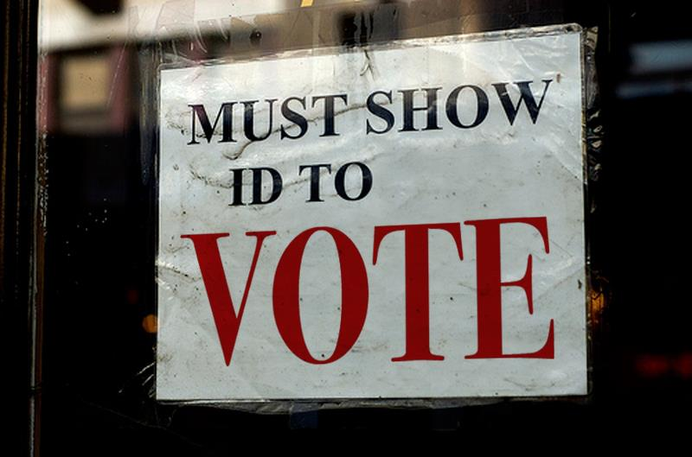
The high cost of a “free” photo ID

Slide 2
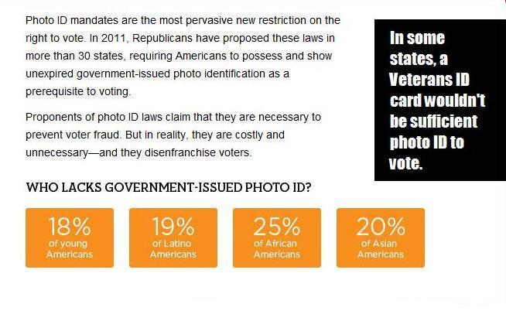
Voter ID Laws

Slide 3
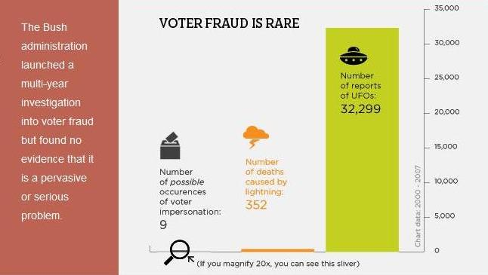
Voter ID Laws

Slide 4
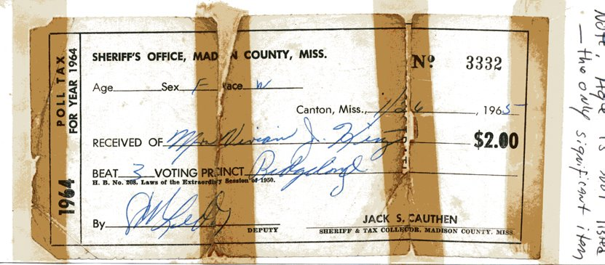
$2 Poll Tax Receipt, 1965

Slide 5
1965 Poll Tax Rates
State | Amount | 2011 Equivalent
Alabama | $1.50 | $10.78
Georgia | $2.00 | $14.38
Mississippi | $2.00 | $14.38
South Carolina | $1.00 | $7.19
Tennessee | $1.00 | $7.19
Texas | $2.00 | $14.38

Slide 6
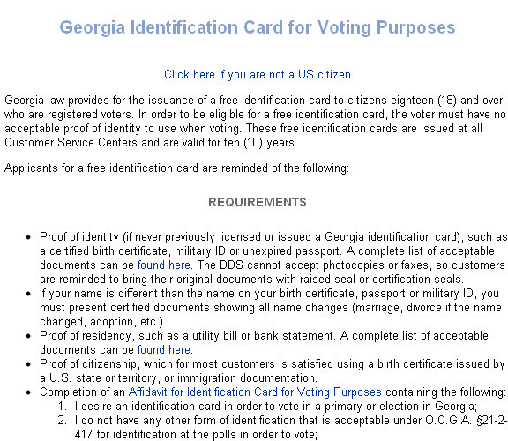
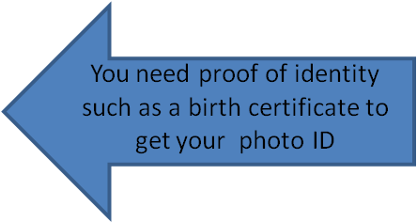
How to get a voter ID card in Georgia….
Source: http://www.dds.ga.gov/drivers/dldata.aspx?con=1749371755&ty=dl

Slide 7

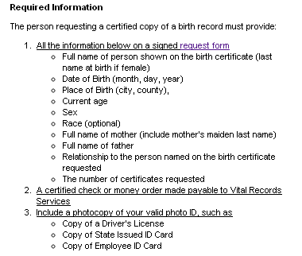
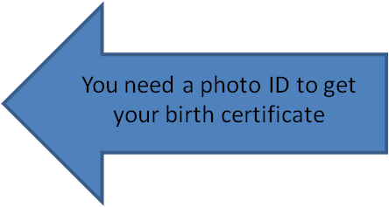
How to get a voter ID in Georgia, continued….
Source: http://health.state.ga.us/programs/vitalrecords/

Slide 8
How to get a voter ID in Georgia, continued….
Costs:
Birth Certificate Fee: $25
plus….
Certified check/money order fee
Transportation to/from processing center
Postage
…easily more than $30

Slide 9
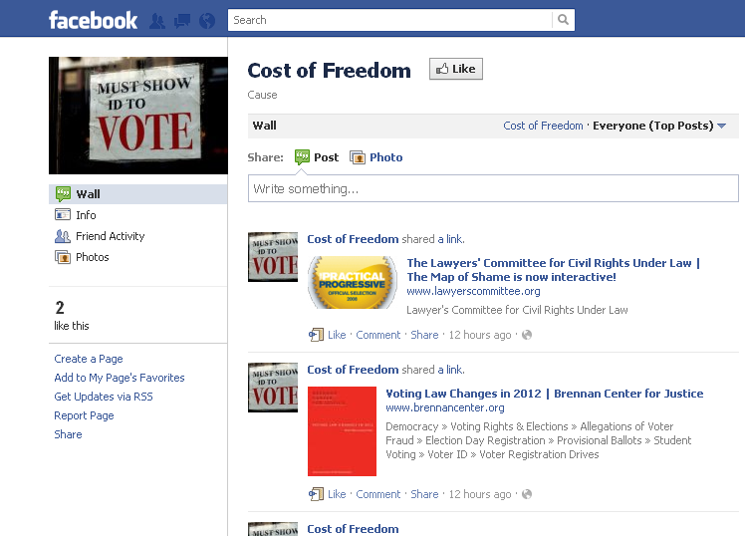
Follow us on facebook

Slide 10
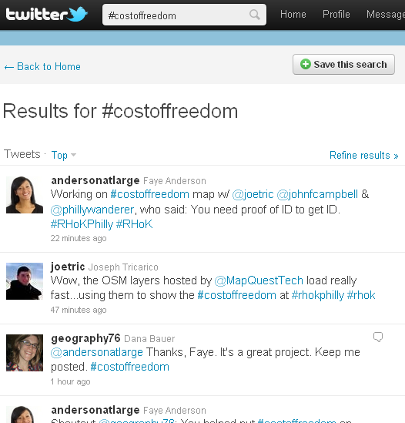
…and on twitter
#costoffreedom

